Slide 1

Recurring Payment Automation using Request Network
Hackathon Project for Request Network Bounty
By Maxim Dovnar,
BY Maria Dovnar

Slide 2

Problem and Solution
Problem
Solution
Managing recurring payments to remote employees can be time-consuming and complex.
Automate the payment process using Request Network to create, manage, and forecast recurring payments efficiently.

Slide 3
Key Features
1
Create and manage recurring payment contracts using Request Network
2
Automate invoice generation and mass payments
3
Display real-time transaction data from Request Network
Automate invoice generation and mass payments
Display real-time transaction data from Request Network
Create and manage recurring payment contracts using Request Network
4
Provide budgeting and forecasting tools for future payments
5
Notify users of payment statuses and failed transactions
Provide budgeting and forecasting tools for future payments
Notify users of payment statuses and failed transactions

Slide 4




How It Works
Businesses create contracts for remote employees with recurring payment schedules.
Businesses create contracts for remote employees with recurring payment schedules.
Request Network automatically generates payment requests based on contract terms.
Request Network automatically generates payment requests based on contract terms.
The app tracks and displays transaction data, providing real-time insights.
The app tracks and displays transaction data, providing real-time insights.
Users receive notifications for upcoming payments or failed transactions.
Users receive notifications for upcoming payments or failed transactions.

Slide 5
Why It Can Win
Automates a common business need: paying remote employees efficiently.
Uses Request Network for secure and transparent payments.
Automates a common business need: paying remote employees efficiently.
Uses Request Network for secure and transparent payments.
Combines payment automation with real-time data visualization and analytics.
Provides value for businesses looking to scale and manage multiple remote employees.
Combines payment automation with real-time data visualization and analytics.
Provides value for businesses looking to scale and manage multiple remote employees.

Slide 6
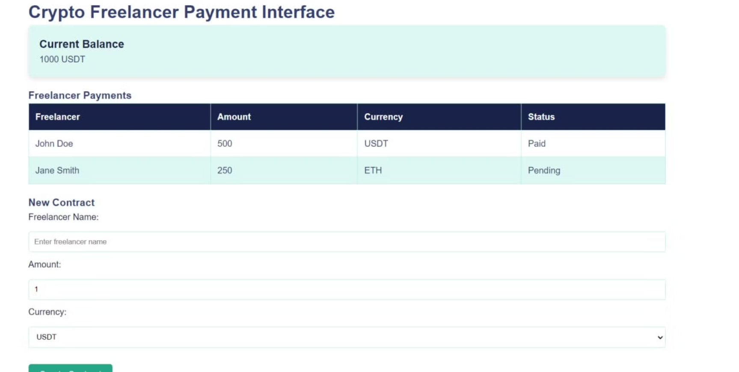
Main panel (Dashboard)

Slide 7

Application interface Main panel (Dashboard)
Provides a comprehensive overview of recurring payments, including upcoming payments, payment history, and contract details.
Contract Management
Allows businesses to create, edit, and manage recurring payment contracts with freelancers.
Payment History
Displays a detailed history of all payments made, including dates, amounts, and transaction IDs.
Notifications
Sends alerts to users about upcoming payments, payment confirmations, and failed transactions.
Reporting and Analytics
Provides insights into payment trends, budget forecasting, and overall payment performance.

Slide 8

contact us
For inquiries or feedback, please contact us at ceo@depotly.io Maxim Dovnar
cmo@depotly.io Maria Dovnar
t.me/depotly_chat https://depotly.io/en

